Slide 1

WAY TO ENTERPRISE
Java Basics
VTI ACADEMY
Author: duy.nguyenngoc1@vti.com.vn
March 2020

Slide 2
Agenda
Static
Final
File
IO Stream
Assignments
Copyright © VTI Academy All Rights Reserved

Slide 3
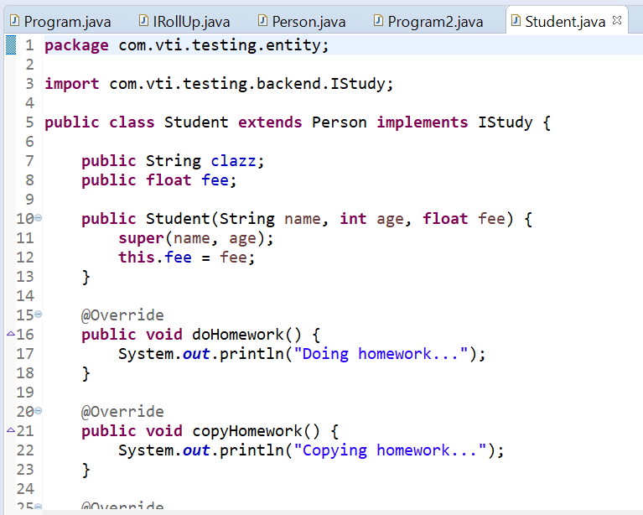
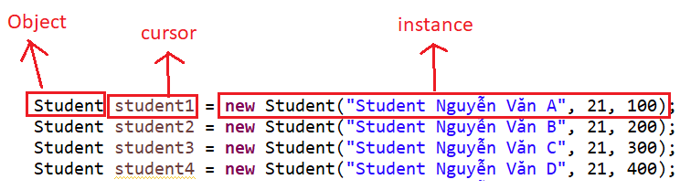
Object & Instance

Slide 4
Static
Property belong to instance
Static belong to Object
Saving memory

Slide 5
Static
Static method
Static property

Slide 6
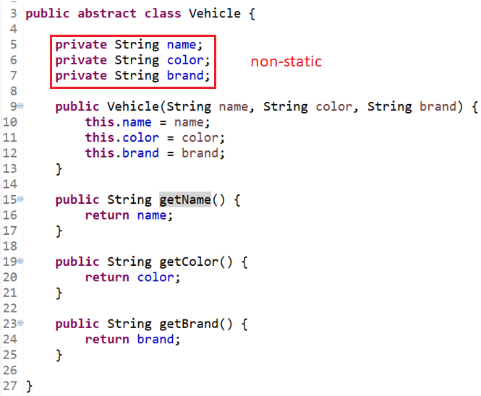
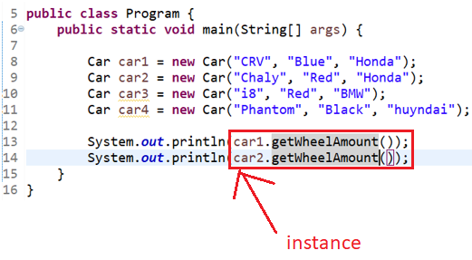
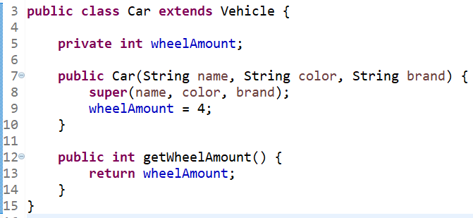
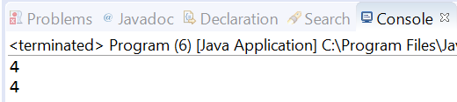
Non Static

Slide 7
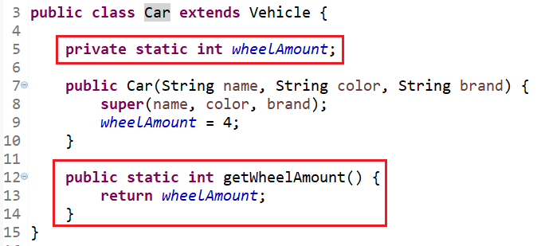
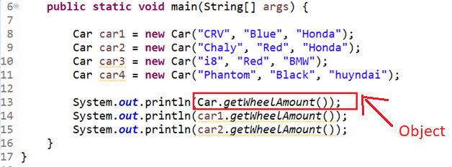
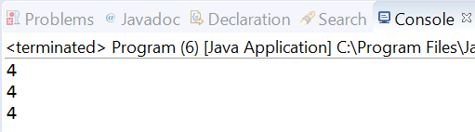
Saving memory

Slide 8
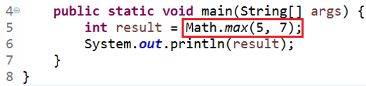
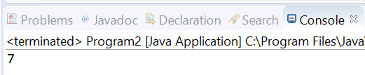
Static Method

Slide 9
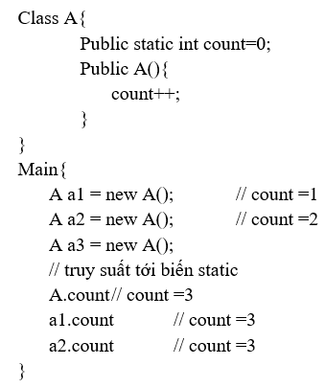
Count Object Example

Slide 10
Final
Final variable
Final variable and Constructor
Final method
Final class
Final parameter
Static final (declare constraint)

Slide 11
File
Check File is exists
Create file
Delete file
Check path is File or Folder
Get all File of Folder
Rename File
Moving File

Slide 12
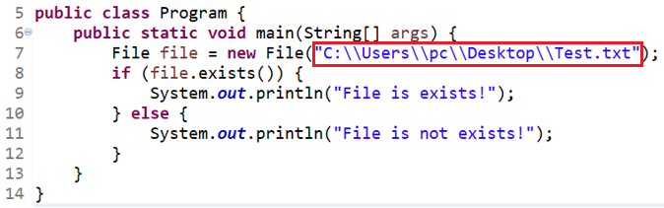
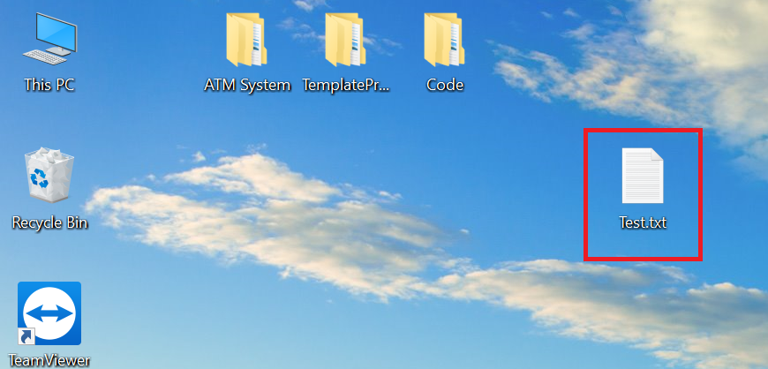
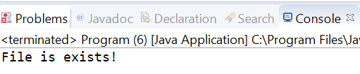
Check File is exists

Slide 13
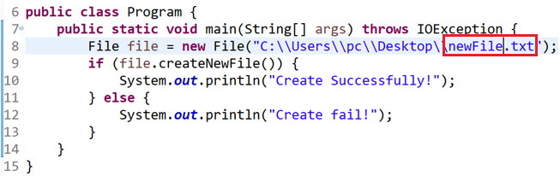
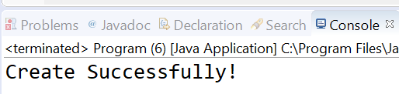
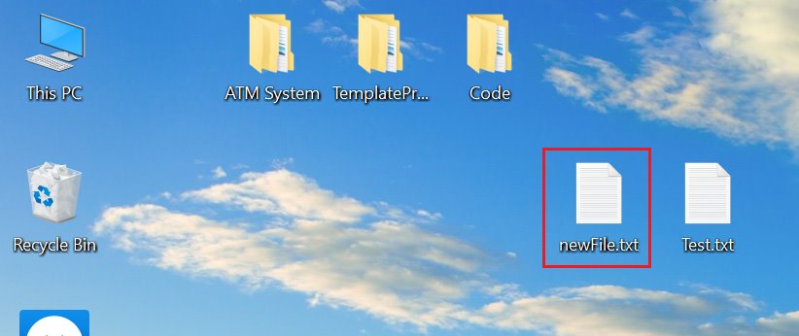
Create File

Slide 14
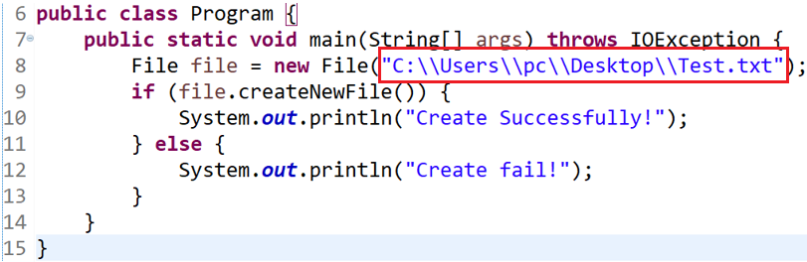
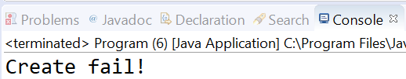
Create File

Slide 15
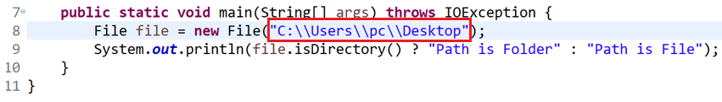

Check path is File or Folder

Slide 16
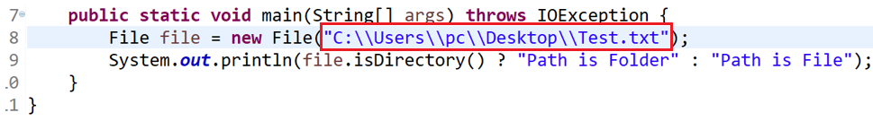
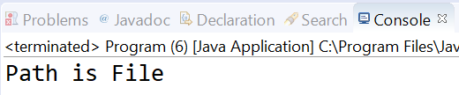
Check path is File or Folder

Slide 17
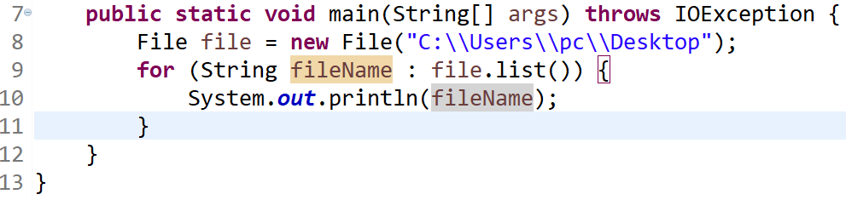
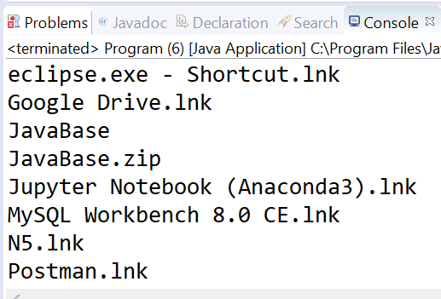
Get all File of Folder

Slide 18
IO Stream
ByteStreams (read byte)
ObjectStreams (read Object)
CharacterStreams (Read characters)
BufferdStreams (Read multiple data)

Slide 19
ByteStreams
Read file
Write file

Slide 20
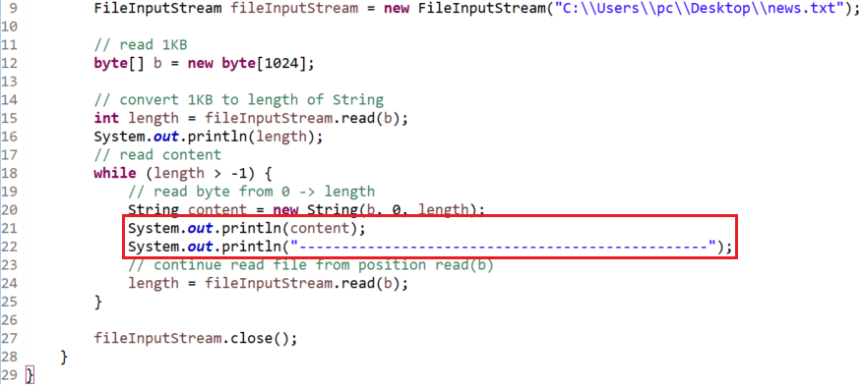
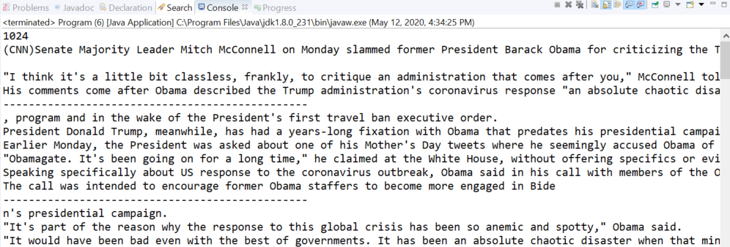
Read file

Slide 21
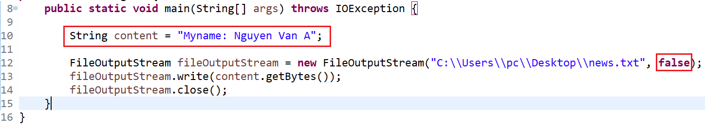
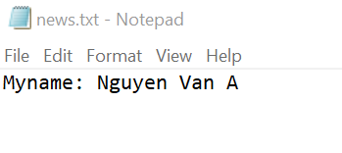
Write file (replace content)

Slide 22
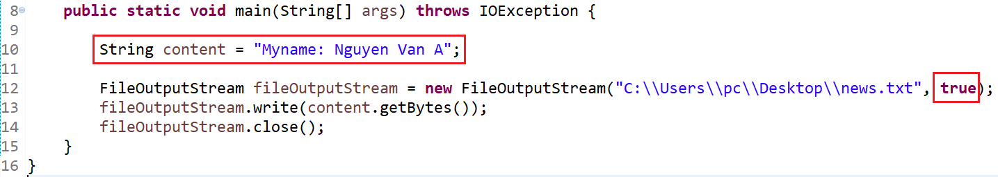
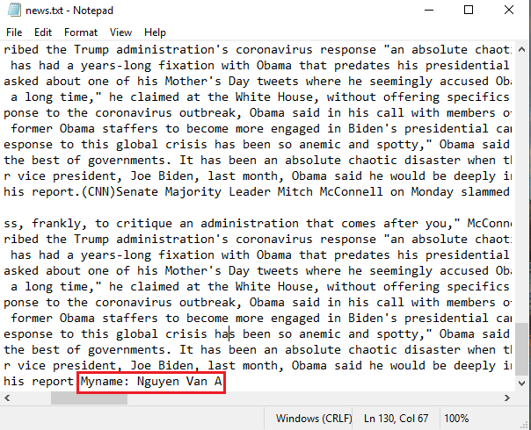
Write file (continuing content)

Slide 23
ObjectStreams
Read Object
Write Object

Slide 24
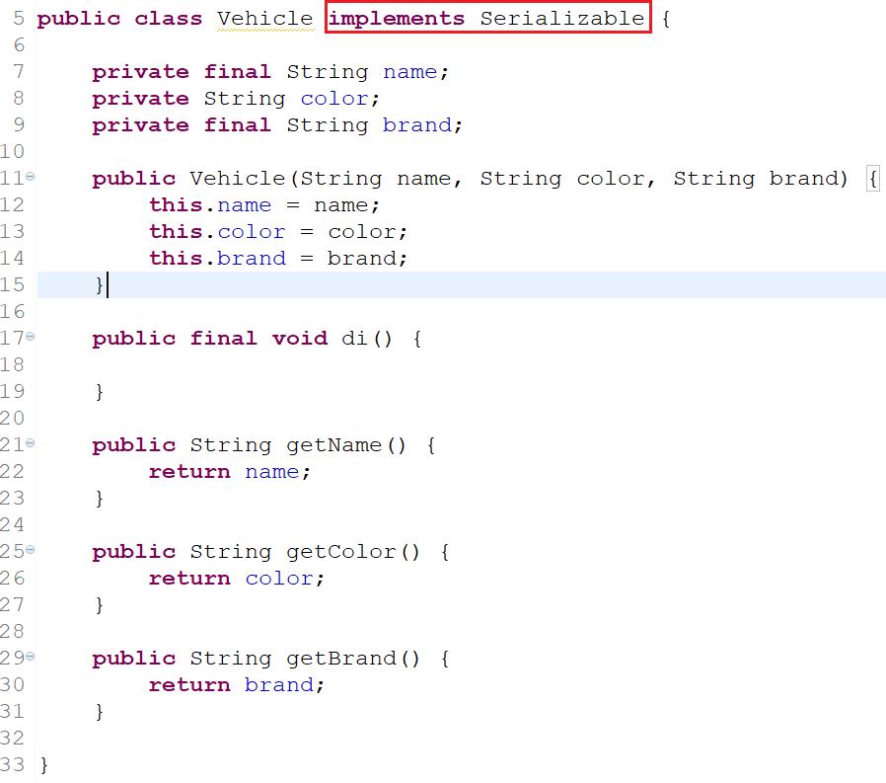
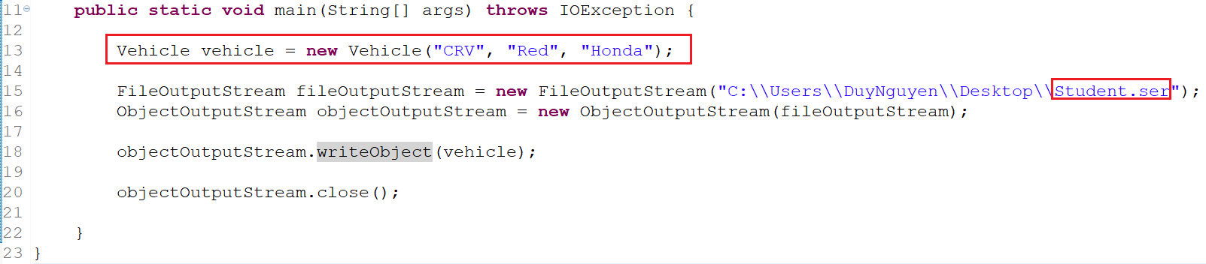
Write Object

Slide 25
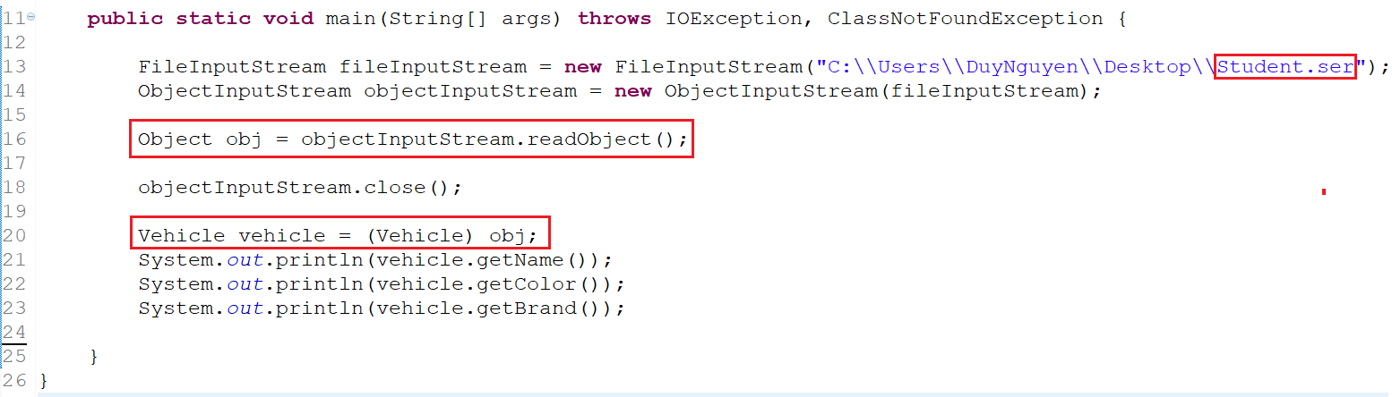
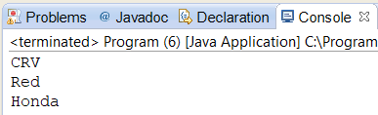
Read Object

Slide 26
ObjectStreams
Serializable
Transient

Slide 27
Assignments 1

Slide 28
Assignments 2
Assignment for Testing System

Slide 29
Q & A
Copyright © VTI Academy All Rights Reserved

